Slide 1
NBA injuries through the years
Data collection from the web, EDA visaulisation and machine learning
By Segev Bavli and Yevgeni (Jeanya) Karpilovsky

Slide 2
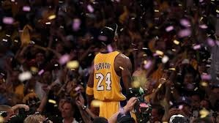
The purpose of our project
Find if there is any correlation between certain aspects of the game and injuries of NBA players
Find whether we can predict random injury of random player and the efficiency of our prediction
Find out whether we can prevent a future injury with our prediction

Slide 3
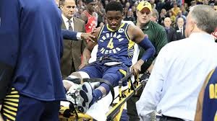
Sources
www.basketball-reference.com/leagues
www.basketball-reference.com/teams
www.prosportstransactions.com/basketball/Search

Slide 4
Data collection
We have used the BeautifulSoup library to receive all the data that we needed by crawling
Than we saved all the data we have collected in 3 different csv files. We saved it like that to save time. Moreover, later we will modify those csv files for different research purposes
player_stats
all_teams_schedule
prosportstransactions_scrape_missedgames

Slide 5
Data cleaning – standardize names
We created a dictionary of teams in the NBA called “team_reference” and “team_short_dict” because teams have different references in certain sites we used
We changed the names of the player in each dataframe to a single name without any second names or signs
We have updated the names of the franchises that have moved to another city or changed their name
We changed some of the dates to the same structure

Slide 6
Data cleaning – Dealing with unnecessary data
We removed all the players who played less then 20 min average per season, these are our outliers
removed unnecessary columns
We have dropped duplicates
We used “dropna” function to drop the unexciting rows (we double checked that it did not hurt the data)

Slide 7
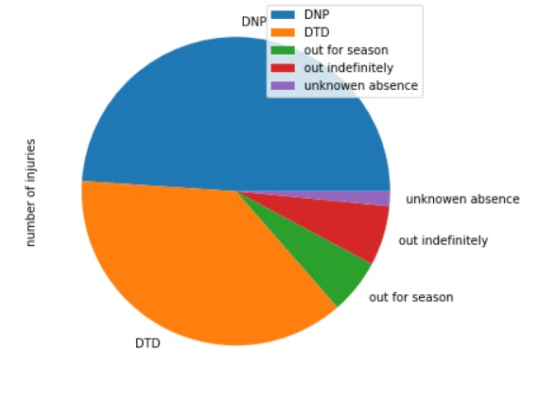
EDA – visualization and conclusion
We have checked the sorts of the absences of the injured players through the years
The common absence is DNP – a player did not play because of a certain reason (later we will find out what are the reasons)

Slide 8
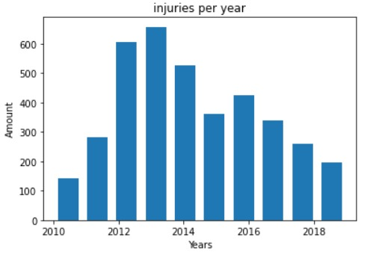
EDA – visualization and conclusion
We have shown the amount of injuries per year
Years 2012 and 2013 are the years in which the most of the players got hurt. The drastic drop in the following years accrued probably because of the change in the play-style in the league

Slide 9
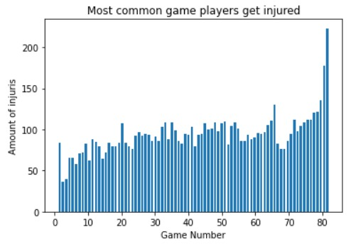
EDA – visualization and conclusion
We found the most common number game that the players get injured on
The most common games in which players get injured on are the last two games of the season. When the playoffs and fame are on the line, all of the the players will do anything to go into the history books

Slide 10
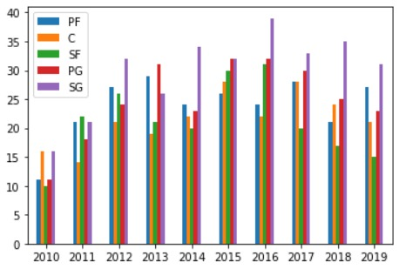
EDA – visualization and conclusion
We have merged several dataframes to find the position of players that are most likely to get injured on
The most dangerous position is the shooting-guard (SG). Those players are the most athletic and fearless players. For example Kobe Bryant and Micheal Jordan

Slide 11
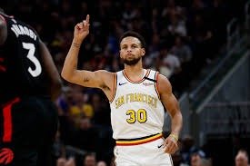
Machine Learning
We used three types of machine learning
- LogisticRegression
- Decision Tree
- KNN

Slide 12

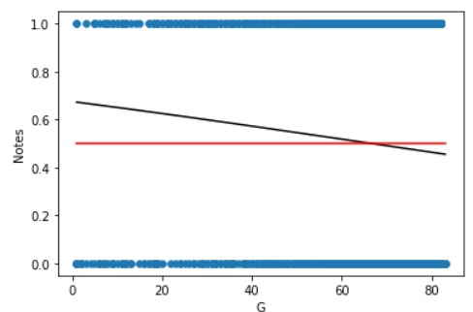
ML - LogisticRegression
In the beginning of the research we thought that there would be a direct connection between the number of games that the player played and whether he was injured or not. So we used two parameters. Firs was the number of games and the second was injured or not (0 – if not injured and 1 – if indeed was injured).
We decided to use LogisticRegression
However to our surprise, the accuracy
of the prediction was fairly lower than
expected (0.526). it is fairly low percentage
however, injuries are pretty random so we decided
that there is some connection between both

Slide 13
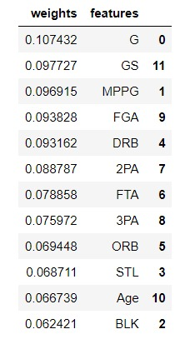


ML- Decision Tree
We have checked if the total stats of the player determine whether we can predict his injury or not. We used decision tree for this matter. Our y-vector was notes (0 – if not injured and 1 – if indeed was injured). All the rest was the X matrics (we left all the dataframe as is because by the stats we can determine the play-style of the player).
On the one hand, we have found that it causes over-fitting. On the other hand, we can not add any more parameters to the statics columns as players always measured the same way for nearly hundred years.
In the table we can see which of the following columns will have the most weight on the decision tree.
As a result we can reach almost 60 percent accuracy of prediction.

Slide 14
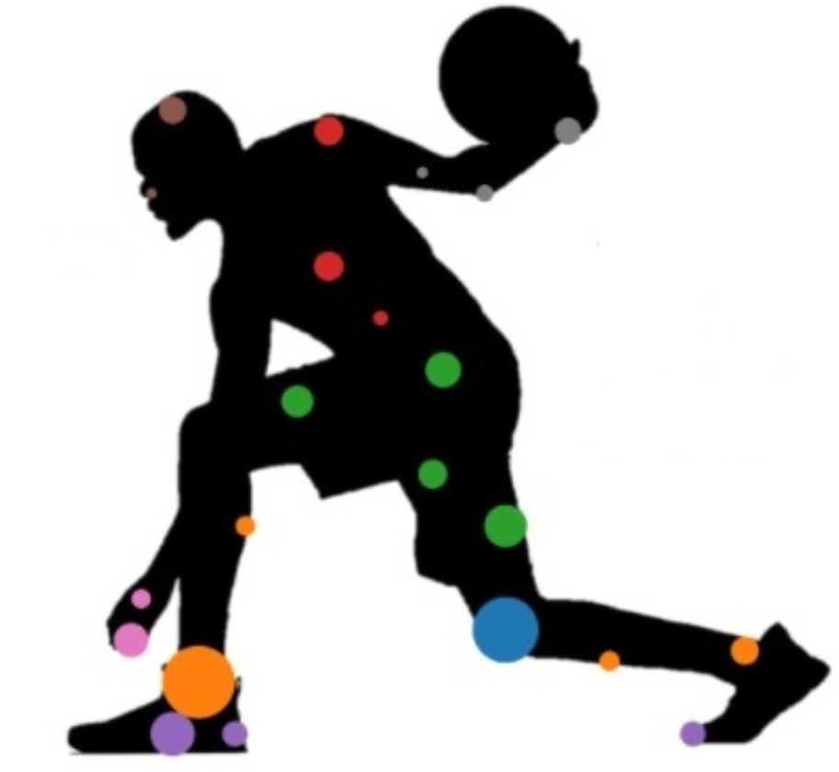
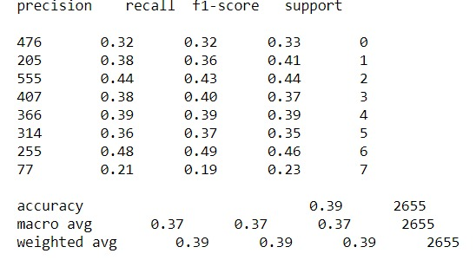
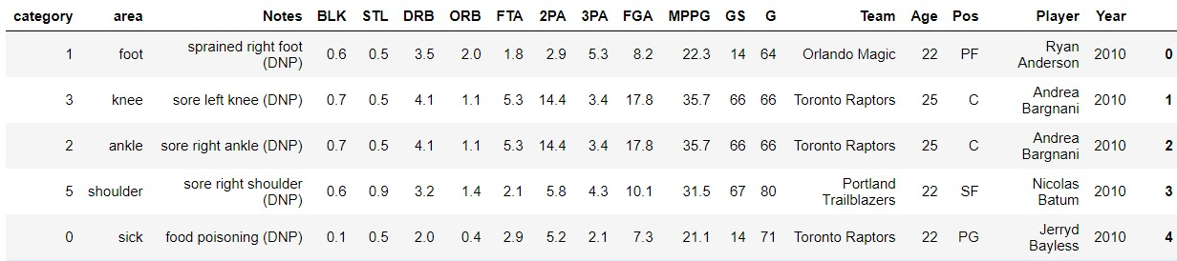
ML - KNN
As we continued with the research, we wanted to be able to predict in which part of the body a random player will be injured. We used the KNN algorithm. We used StandardScaler and we found that the best k is 1. However, for all parameters of k everything in the table remained almost the same. As we can see we can not predict where a player will be injured by the data we gathered

Slide 15
Project conclusion
As we can see, players injuries can be predicted but not accurately. It can help teams to determine which players need rest and which can play, and make the load management much more easier. The injuries of players can be critical not only for the chance of winning but also for incomes and business as fans wants to see the best players on court. So if we can predict even by 60 percent it is much better than what exists today.
Although we can find out the risk of the injury, we can not predict the part of the body which the player will be injured with the data we have

